Slide 1
Presentation on Student management system
Green University of Bangladesh
Department of Computer Science & Engineering
Course code: Cse-210
Presented to,
Name: Fatema-Tuj-Johora Designation : Lecturer
Department: Cse
Green university of Bangladesh
Presented by,
Name: Md. Nur A Neouse &
Md. Jakirul Islam
Id. 193002093 & 193002101
Section: 193(Db)
Department: Cse
Green university of Bangladesh

Slide 2
Content
Login page
Overview
Student classes
Subjects
Students
Admin change password
2

Slide 3
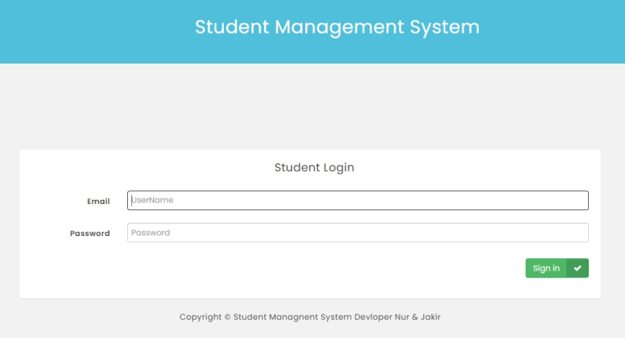
Login page
3

Slide 4
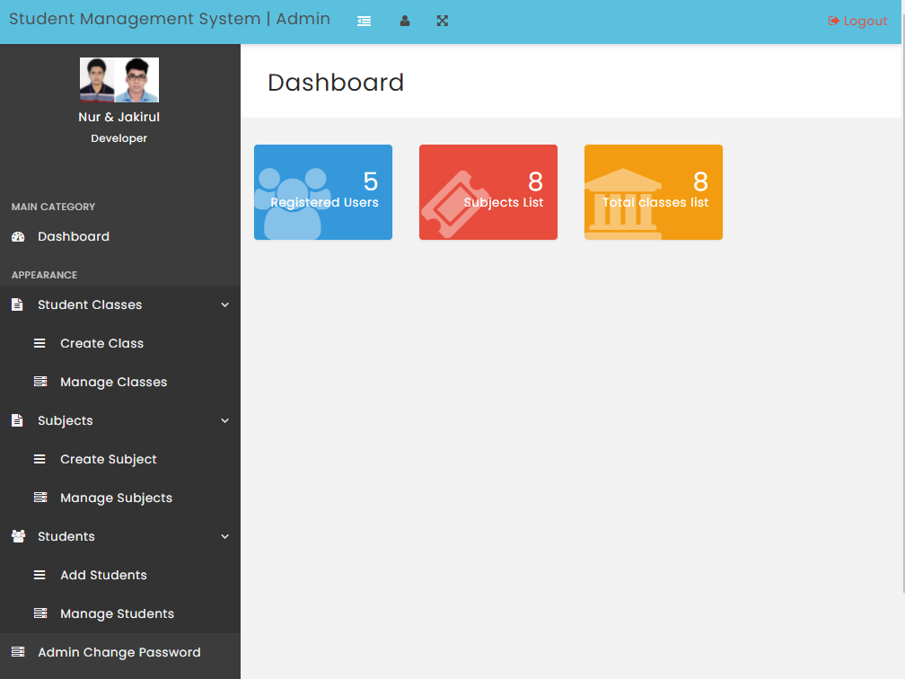
Overview
4

Slide 5
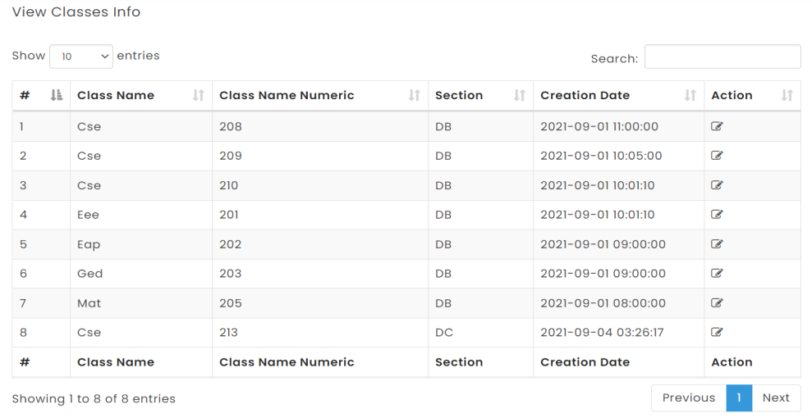
Student classes
Create class
Manage classes
5

Slide 6
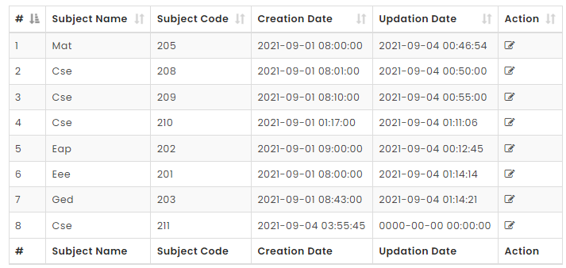
Subjects
Create subject
Manage subjects
6

Slide 7
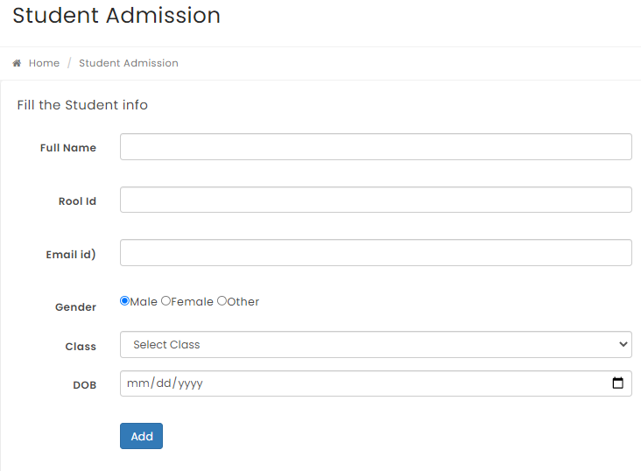
Students
Add students
7

Slide 8
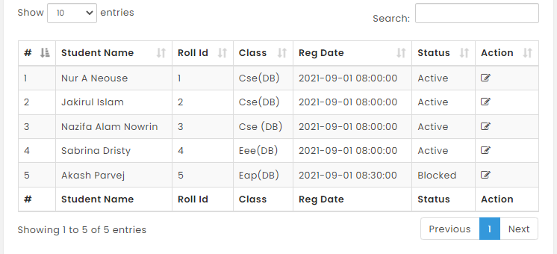
Students
Manage students
8

Slide 9
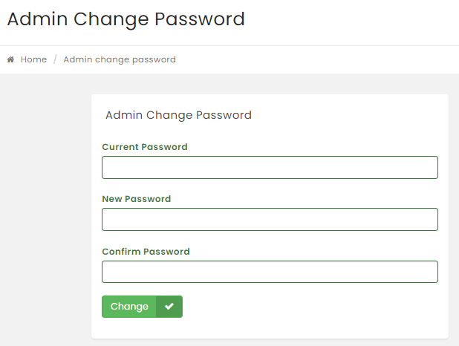
Admin change password
9

Slide 10
Thank you everyone
10

